Slide 1
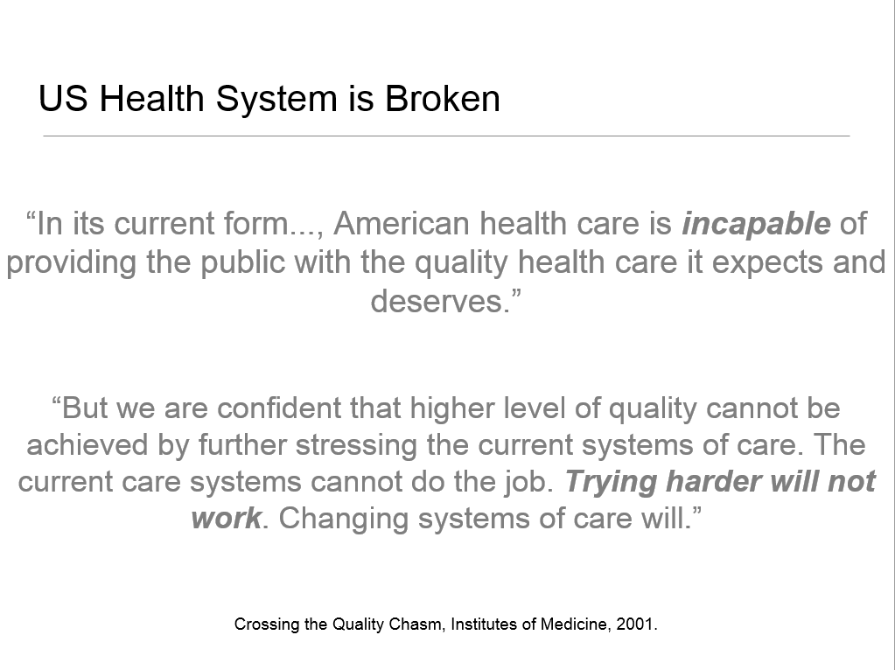

Slide 2
HIGHLIGHTS IMPCAMP 2014
“Health care is cannibalizing health”
- Michael Fine, MD
“The quality train is on the wrong track “
- L Gordon Moore MD
“Performance measures - P4P, PQRS, and quality indexes - are examples of the problems, not the solutions”
- Robert Berenson, MD

Slide 3

DISEASE BASED METRICS (HEDIS) AND POINTILLISM
How many points are needed for a picture?
Jean Metzinger, 1906, Woman with a Hat

Slide 4
Right tool for right job data

Slide 5


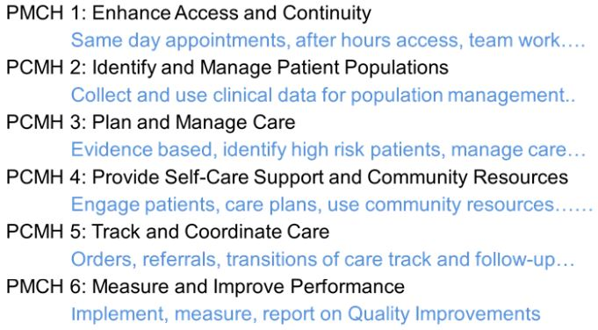
AS MEASURES | AS ACTIONS
YES | PRACTICE DEPENDENT
YES | REGISTRY
YES | TAILORED PLAN
YES | CUSTOM BY ZIP
YES | PORTABLE PLAN
YES | PRACTICE DEPENDENT
Notes:
chart review derived vs patient derived
5

Slide 6
How’s Your Health
Assessment Tools
Actionable Feedback
Patient and Community Resources
Improvement and Certification Measures
Customization
Evolving Since 1994
BMJ 2015;350:g7818 doi: 10.1136/bmj.g7818 (Published 10 February 2015)
Notes:
6
Patient entered web based survey that gathers determinants of health and health care.
Produces a summary of health assets / needs for the patient in front of you.
Aggregated behind the scenes to give your practice actionable primary care and bio-clinical metrics

Slide 7
What is “HowsYourHealth”
Patient entered web based (3-part) survey that gathers determinants of health and health care.
Produces a summary of health assets / needs for the patient in front of you.
Aggregated behind the scenes to give your practice actionable primary care and bio-clinical metrics
Free !
patients do the work!
10-20 minutes

Slide 8

Can you take the health/ health care survey at the link below before you come in for your appointment ?
https://howsyourhealth.com/dispatch?code=IMP107
At the end of the survey on the second page, please fill out your information to send the survey results on that page to me
Thank you! This helps me with your care and to improve the practice !

Slide 9
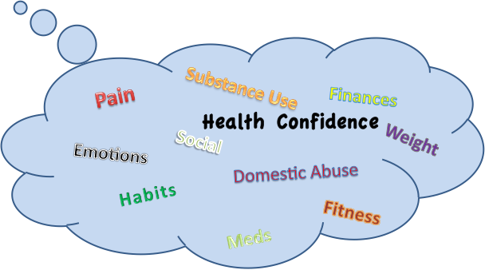

Short (Medicaid/Medicare)
or Comprehensive Versions
FOR
PATIENTS
Reading Level for General Public
What Matters to Patients/Caregivers
Assessment Tools
Validated and Immediately Actionable
Tailored Information, Tools
and Community Links
Meds
Notes:
9

Slide 10

10 Important Primary Care Things
Pain
Substance Use
Finances
Social
Weight
Emotions
Domestic Abuse
Habits
Fitness
Meds
Brought to you by HowsYourHealth

Slide 11



Examples of Primary care screening questions

Slide 12
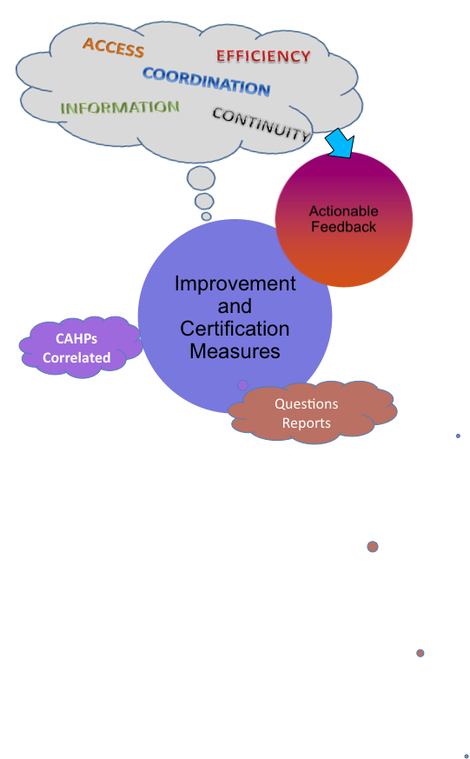
FOR PRACTICES
Data Continuously Aggregated “Behind the Scenes”
Designed for “Patient Voice”, Medicare Wellness and End-of Life Requirements
Standard and Valid Metrics; CAHPs Option
Tools, Registry and Population Level Data
Notes:
12

Slide 13

5 Key Practice Measurements
EFFICIENCY
ACCESS
COORDINATION
INFORMATION
CONTINUITY
Brought to you by HowsYourHealth

Slide 14


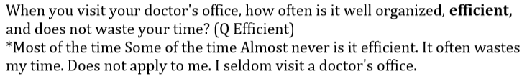

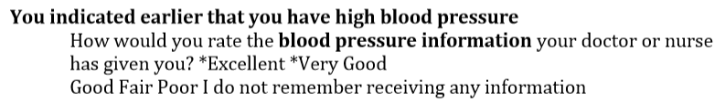
EXAMPLES OF PRACTICE QUALITY QUESTIONS

Slide 15
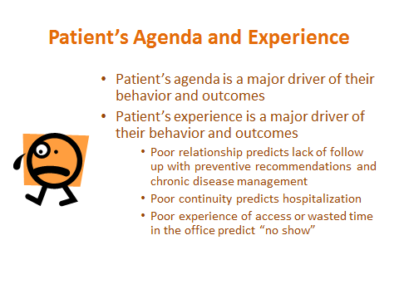
Hows your health elicits the Patient’s Agenda and experience of care
Notes:
HYH elicits pt agenda and pt experience of care
Examples of patient agenda “ pain” “ med sid effects predict s

Slide 16

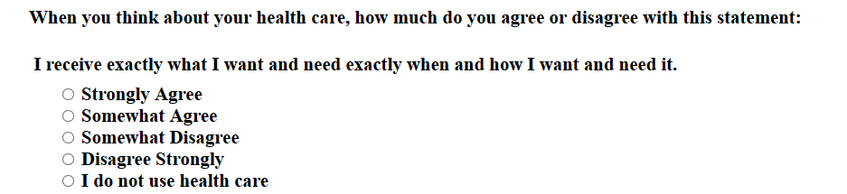

Orphan Power Questions

Slide 17
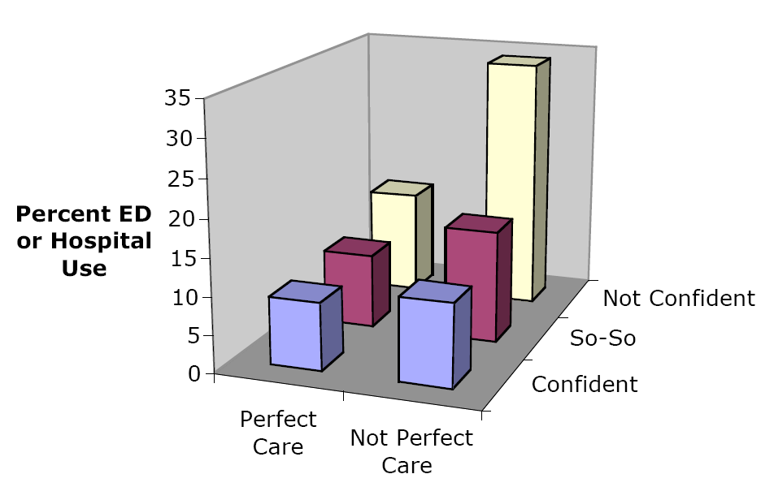
Confidence, Perfect Care and ER/Hospital Use
JH Wasson

Slide 18
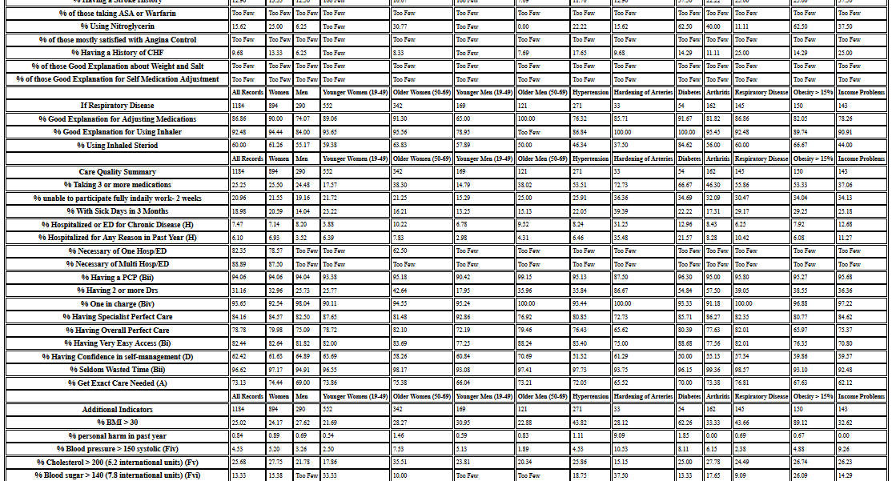
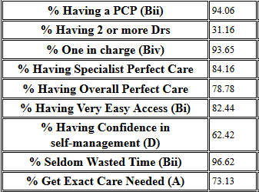
8/10/15
Notes:
How many surveys do you need?

Slide 19
HowsYourHealth
Screen all, summarize each
Practice metrics
Registry for high risk patients
Actionable data for improvement
patient information-problem solving links-medical home measurement-CAHPs
PLUS!

Slide 20
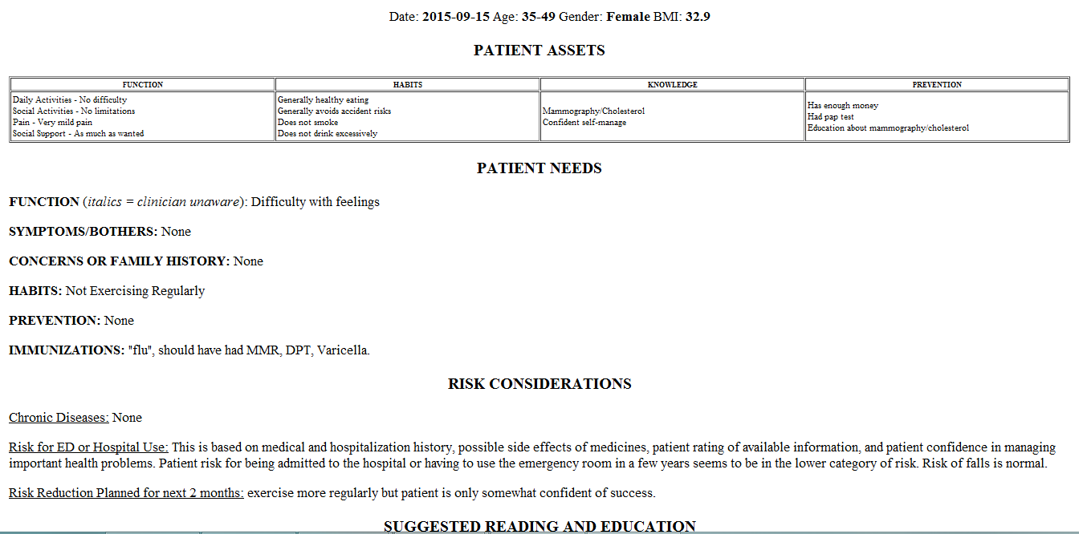
Patient 1

Slide 21
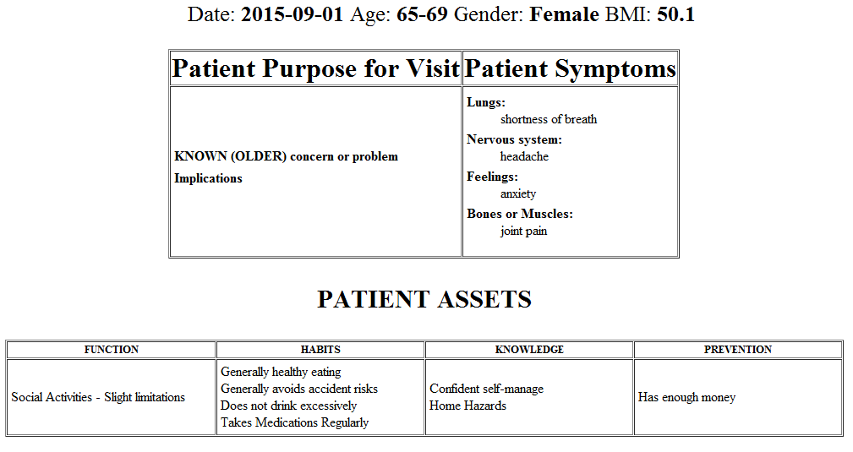
Patient 2, Page 1

Slide 22
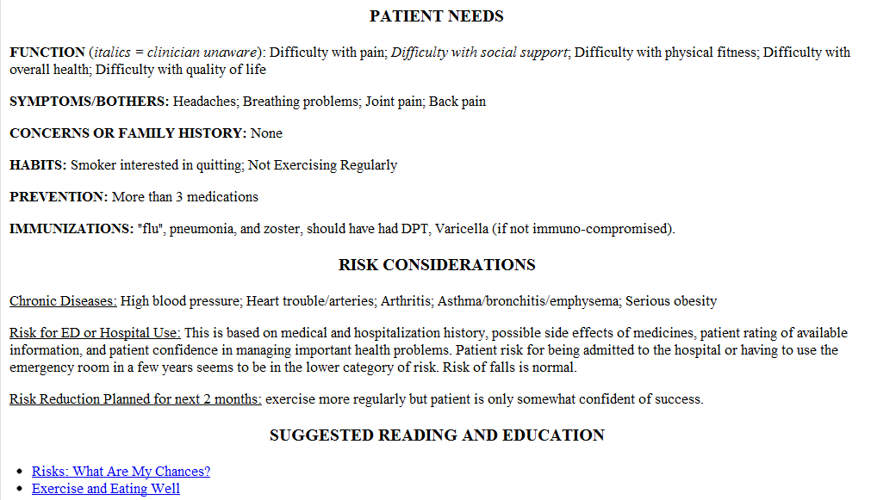
Patient 2 Page 2

Slide 23
HowsYourHealth
Screen all, summarize each - 10 important domains
Practice metrics - 5 key practice measures
Registry for high risk patients
Real-time actionable data for improvement
patient information-problem solving links-medical home measurement-links to local resources--CAHPS
PLUS!

Slide 24
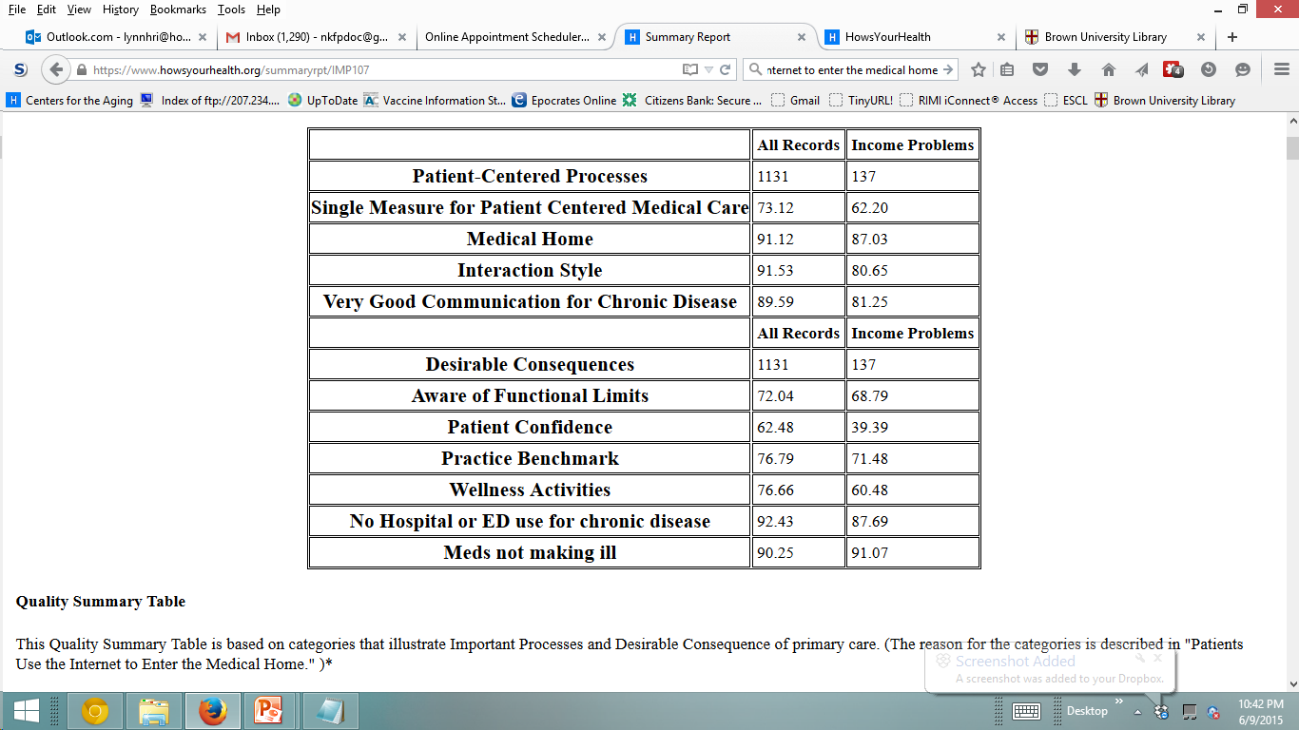
MEDICAL HOME SUMMARY - HOWSYOURHEALTH

Slide 25
National Benchmarks, HYH
Exactly the Care…: median 30; upper third over 40.
Medical Home: median 65; upper third 75.
Interaction: median 55; upper third 70.
Excellent Information for Chronic Disease(s): median 70; upper third 80.
Aware of Functional Limits: median 50; upper third 65.
Patient Confidence/Self-Management: median 50; upper third 55.
Preventive and Clinical Benchmarks: median75; upper third 80.
Patient Habits Generally Healthy: median 70; upper third 75.
No ED or Hospital Use in Year: median 90; upper third 92.
Patient Convinced Medications for Chronic Disease(s) Not Causing Illness: median 80; upper third 85.

Slide 26
HowsYourHealth:
Screen all, summarize each
Practice metrics
Registry for high risk patients
Actionable data for improvement
patient information-problem solving links-medical home measurement-CAHPs
PLUS!

Slide 27
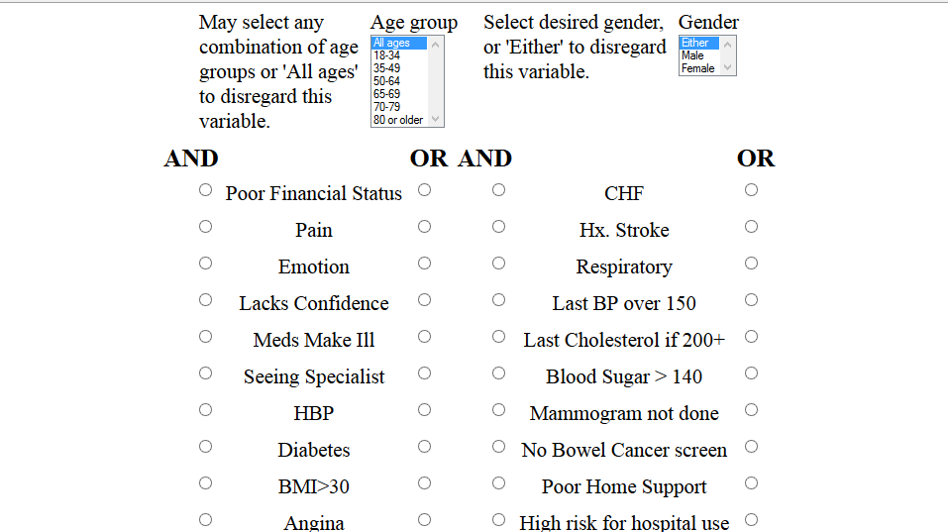

Slide 28
HowsYourHealth
Screen all, summarize each
Practice metrics
Registry for high risk patients
Actionable data for improvement
patient information-problem solving links-medical home measurement-CAHPs
PLUS!

Slide 29
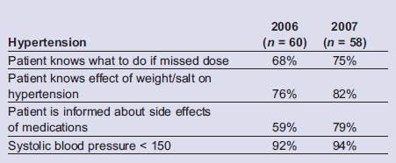
Practice Improvement

Slide 30
How’s Your Health
Assessment Tools
Actionable Feedback
Patient and Community Resources
Improvement and Certification Measures
Customization
Evolving Since 1994
BMJ 2015;350:g7818 doi: 10.1136/bmj.g7818 (Published 10 February 2015)
Notes:
30
Patient entered web based survey that gathers determinants of health and health care.
Produces a summary of health assets / needs for the patient in front of you.
Aggregated behind the scenes to give your practice actionable primary care and bio-clinical metrics

Slide 31
More Information
Go to the HYH website and take a few surveys! Take a survey as if you were quite well, then as if you were very ill. Study and compare the action plans.
www.HowsYourHealth.com
Why we cannot use disease based metrics to measure health quality
Iona Heath’s “Arm In Arm with Righteousness” http://www.pehmed.com/content/10/1/7
Nancy Guinn and Gordon Moore “Practice Measurement: A New Approach…”
http://www.aafp.org/fpm/2008/0200/p19.html
Jim Bloomer’s website about how he uses HYH
http://www.yourmedicalhome.com/howsyourhealthsurveyresults.php
Don Stewart’s recent article on how and why he uses HYH in his practice:
http://www.impcenter.org/#!quality/c1w1w
John Wasson, et.al “Learning from Clinical Microsystems…” , using HYH for practice improvement:
http://tinyurl.com/ojmcko5
Lynn Ho and Jean Antonucci “ The Dissenter’s Viewpoint” why the current measurement paradigm should be scrapped
http://annfammed.org/content/13/3/269.full

