Slide 1


STATE OF RHODE ISLAND AND PROVIDENCE PLANTATIONS
Department of Behavioral Healthcare, Developmental Disabilities and Hospitals
Presented by:
Gary Bliss
Thomas Joyce, LCDP
Christine Harkins, MA, BA

Slide 2
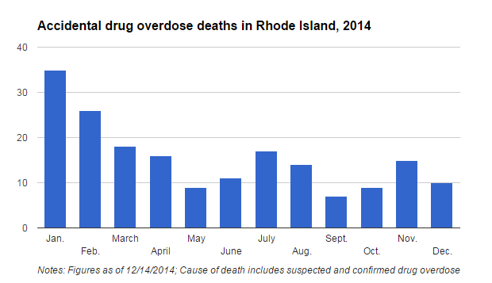

Slide 3
Anchor Community Center
The Providence Center

Slide 4
Title Options in a time of crisis: Helping Patients with addictions in the Primary Care Practices & in the E.D. .
Missed Opportunities to Address Unmet Need
Patients Meeting With Primary Care Physician
Overdose Survivors Treated in the ED

Slide 5
Options in a time of crisis: Helping Patients with addictions in the Primary Care Practices & in the E.D.
Deploying Existing Resources to Meet Need
On-Call Evaluation Resource
Recovery Coaches in the ED - AnchorED

Slide 6
Options in a time of crisis: Helping Patients with addictions in the Primary Care Practices & in the E.D.
The Ideal Ingredients for a Partnership
Identify & Focus on Common/Shared Goals
Flexible & Responsive Funding
Use Existing Community Talent & Capacity
Engage Partners With Credibility With Utilizers & Capacity to Act Fast
Utilize Unique Core Strengths of Partners
Avoid Redundancy, Overlap, Confusion, & Competition

Slide 7
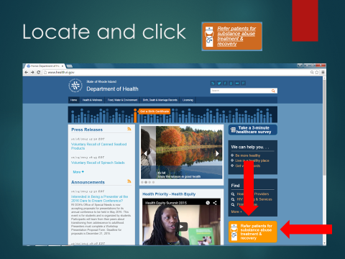
Bridgemark, Inc. Physician Consult Program ww.bridgemark.org

Slide 8
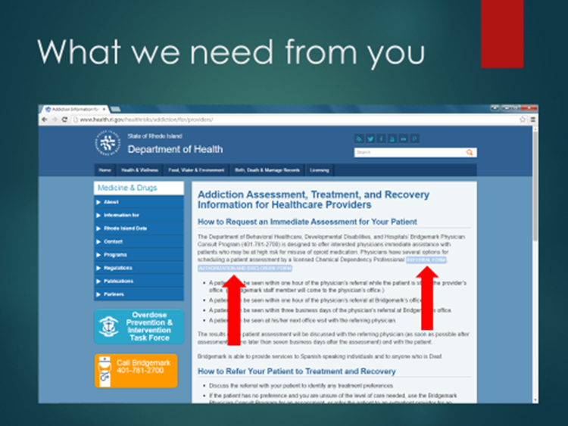

Slide 11
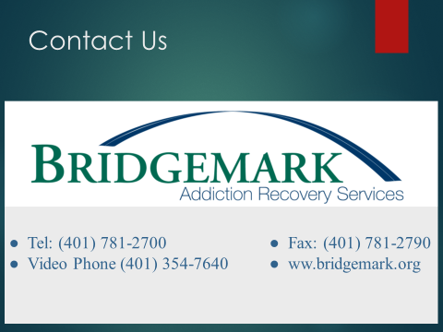

Slide 12


